Slide 1
ABSTRACT
Chatbots, or conversational interfaces as they are also known, present a new way for individuals to interact with computer systems.
Traditionally, to get a question answered by a software program involved using a search engine, or filling out a form. A chatbot allows
a user to simply ask questions in the same manner that they would address a human. The most wellknownchatbots currently are voice
chatbots: Alexa and Siri. However, chatbots are currently being adopted at a high rate on computer chat platforms. A simple chatbot
can be created by loading an FAQ (frequently asked questions) into chatbot software. The functionality of the chatbot can be improved
by integrating it into the organization’s enterprise software. Most commercial chatbots are dependent on platforms created by the
technology giants for their natural language processing. These include Amazon Lex, Microsoft Cognitive Services, Google Cloud
Natural Language API, Facebook DeepText, and IBM Watson. Platforms where chatbots are deployed include Facebook Messenger,
Skype, and Slack, among many other

Slide 2
1. INTRODUCTION
Chatbots, also known as conversational agents, are designed with the help of AI (Artificial Intelligence) software. They simulate a
conversation (or a chat) with users in a natural language via messaging applications, websites, mobile apps, or phone.
There are two primary ways chatbots are offered to visitors:
• Web-based applications
• Standalone applications
Chatbots represent a potential shift in how people interact with data and services online. While there is currently a surge of interest in
chatbot design and development, we lack knowledge about why people use chatbots.

Slide 3
2. LITERATURE REVIEW
The research is based on the survey of various chatbot and it is shown thathow the various chatbot differs from each other's. To make chatbot the various technology has been used to make. Achatbot can be considered as a question-answer system where experts provide knowledge for solicitation of users. A chatbot is a software designed to simulate a conversation with human partner. This survey paper aims to present an overview of an existing approaches of implementing a chatbot system. In this paper it as compares various chatbot from the first chatbot ELIZA to one of the latest chatbot like ALEXA, not only this is as shown various chatbots like IBM Watson, Siri, Tay, etc It tells us about how it is implemented and how they actually work The design and implementation of several chatbots are developed a detail ed survey of those systems.l paper presents on college management Chatbot The college inquiry chat-bots will be built using artificial algorithms that analyse user's queries and understand user's message. The User can ask the question any college-related activities through the chat-bot without physically available to the college for inquiry. The System analysis the question and then answer it to the user. The user can ask any question In this the Chatbot usually remember the previous command in order to provide the functionality. So, whatever the user ask it will remember for it, it will help the Chatbot and it can analysis it for future references

Slide 4
3. TECHNOLOGIES USED
A. Hardware used – Laptop with Installed memory – 4GB and more ram
System type – 64 bit OS
B. Platform
1. Laptop/Desktop
C. Software Tools Used
1. Python
2. This software requirement specification (SRS) report expresses complete description about proposed System. This document includes all the functions and specifications with their explanations to solve related problems.Python is an interpreted, object-oriented, high-level programming language with dynamic semantics. Its high-level built in data structures, combined with dynamic typing and dynamic binding, make it very attractive for Rapid Application Development, as well as for use as a scripting or glue language to connect existing components together. Python's simple, easy to learn syntax emphasizes readability and therefore reduces the cost of program maintenance. Python supports modules and packages, which encourages program modularity and code reuse. The Python interpreter and the extensive standard library are available in source or binary form without charge for all major platforms, and can be freely distributed.

Slide 5
4. METHODOLOGY
The chatbot development methodology blends several modern frameworks and methodologies including design thinking, AI innovation sprints, and agile software development
Artificial Intelligence is the driving force behind the creation of innovative products like autonomous vehicles and chatbots. Recent advancements in Natural Language Processing (NLP) have made chatbots, also referred to as virtual assistants, a great option for improving the customer experience. Answering frequently asked questions, filing claims, checking the status of an order and getting feedback from customers are among the most popular use cases for chatbots. Building a chatbot that offers a good experience to customers requires collaboration from an interdisciplinary team of business analysts, service designers, data scientists, machine learning engineers and software developers. The chatbot development methodology blends several modern frameworks and methodologies including design thinking, AI innovation sprints, and agile software development.

Slide 6
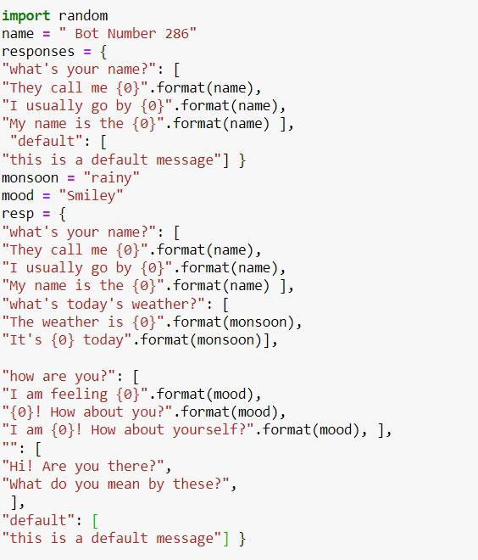

Slide 7
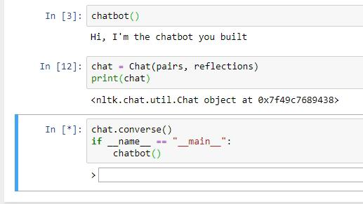

Slide 8
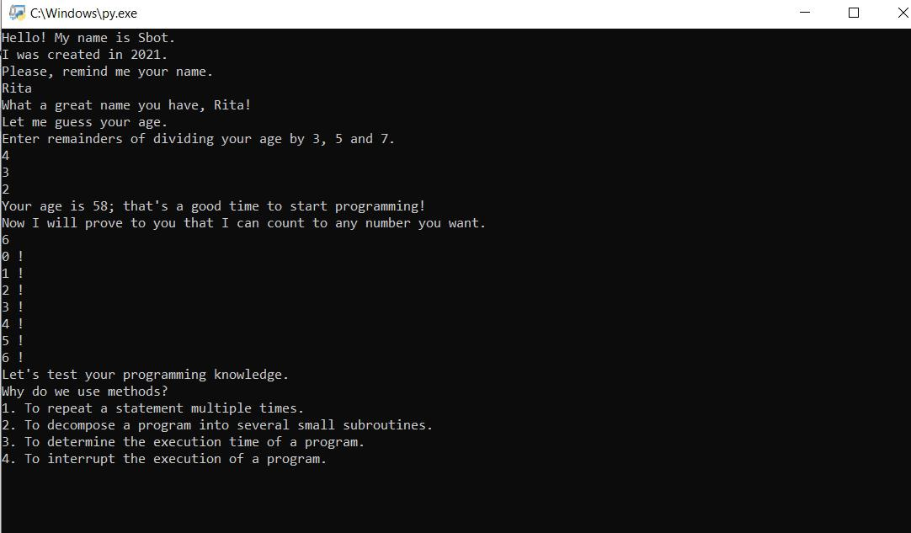

Slide 9
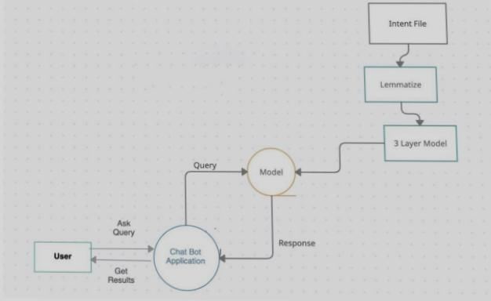
6. ANALYSIS AND TESTING
The given figure below is the data flow diagram of
our chatbot. One can understand and analyze how
and where the data is at a particular moment of
time.

Slide 10
7. RESULTS
The result of our chatbot always varies as it is a
natural language chatbot that can give the same
answer in many different ways. The chatbot always
keeps learning as the number of users increase or
use it more.The accuracy of the chatbot also
increases with the usage of the bot.

Slide 11
8. CONCLUSION
In conclusion we have made a chatbot in python
that can understand user queries and reply
accordingly. In the intent file wetarined our chatbot
on, we can add more patterns and improve patterns
which will be helpful when replying to the users
and improves the accuracy of our chatbot. Deep
Learning enabled chatbots are becoming more and
more popular because of their applications and
problems it can tackle. It can also be very helpful in
teaching and has a lot of applications in teaching
the visually impaired.
9. FUTURE WORK
Our chatbot prototype can not only be used for one
purpose. It can be used in many fields based on the
intent file used to create a training dataset for the
deep learning model to train. A report button can
be added in the chatbot which a user can use when
he feels the chatbot is not giving him the
appropriate answer so that the bot can add the
reported data to the intent file and keep learning
itself. This drastically improves the performance of
the chat bot and it becomes more and more perfect
by prolonged usage.

